Slide 1










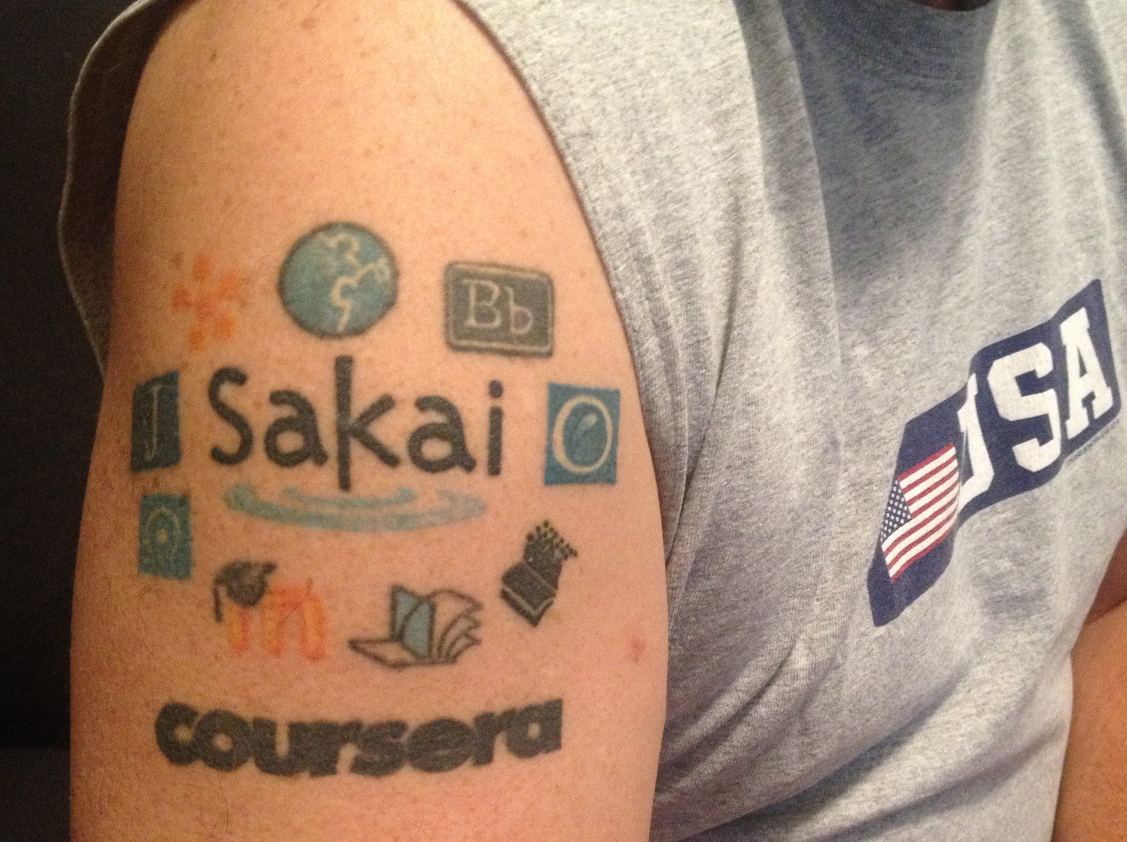
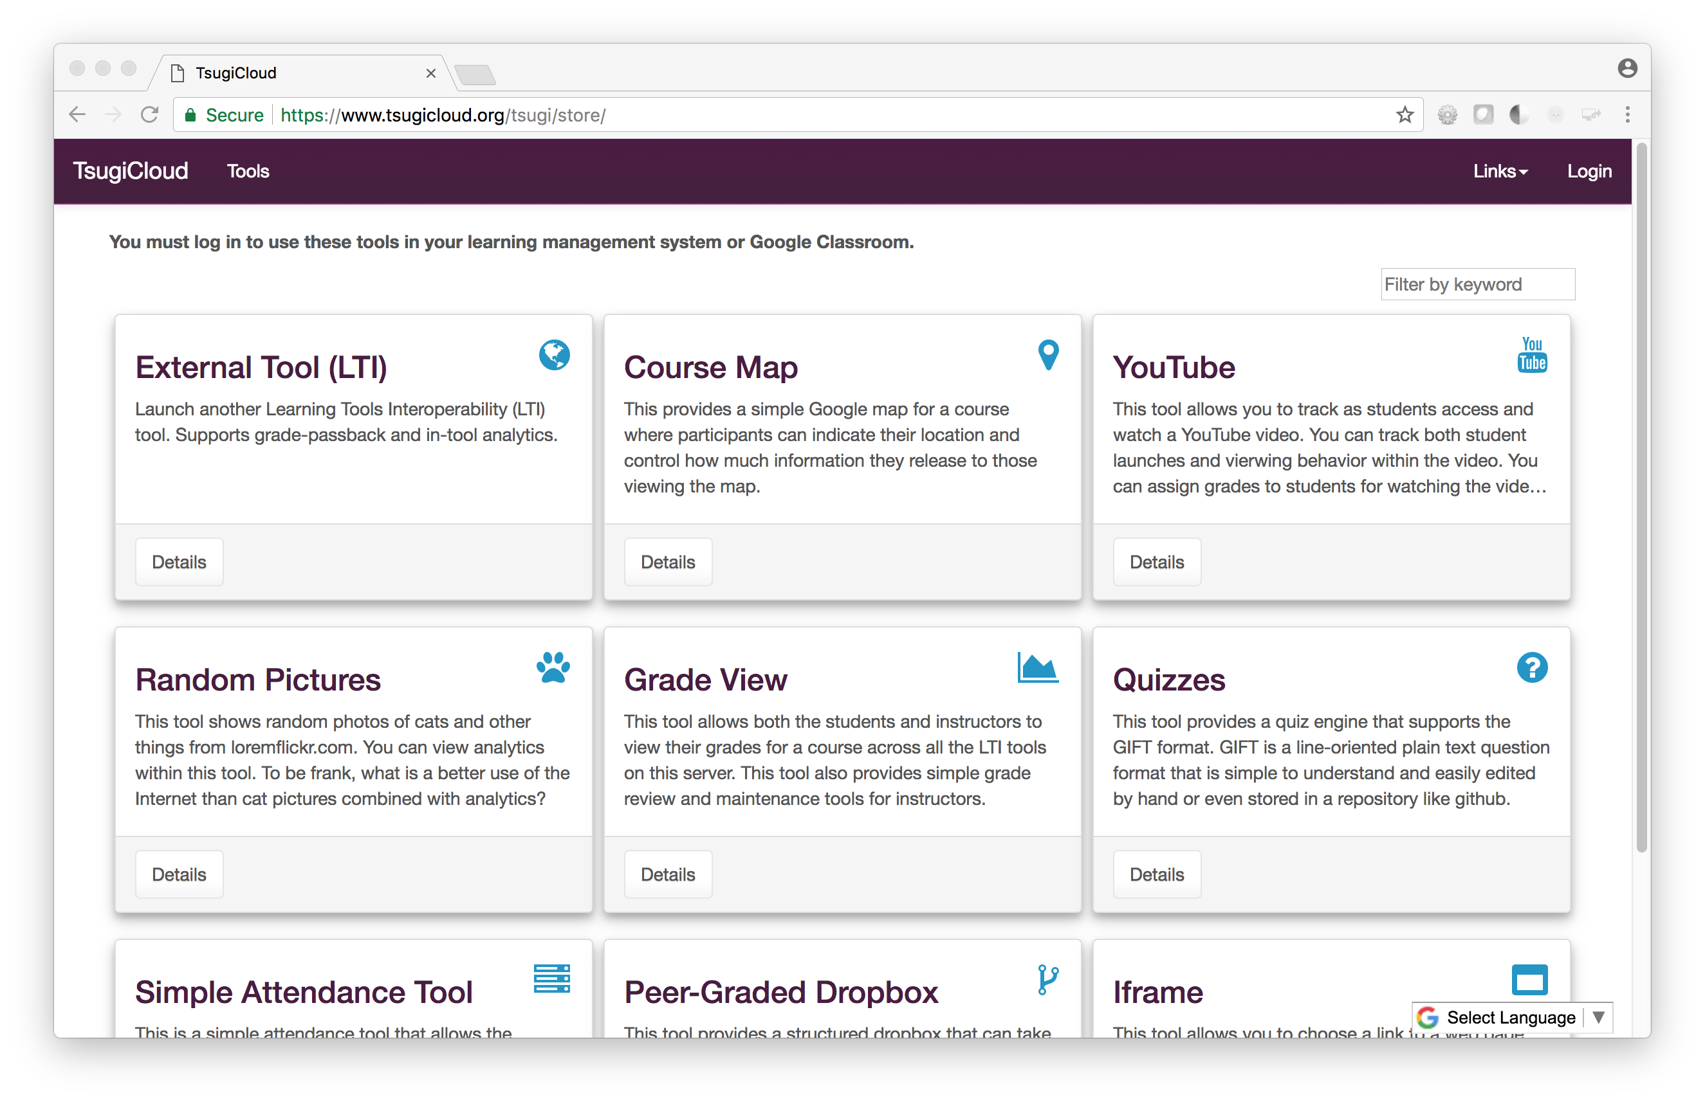
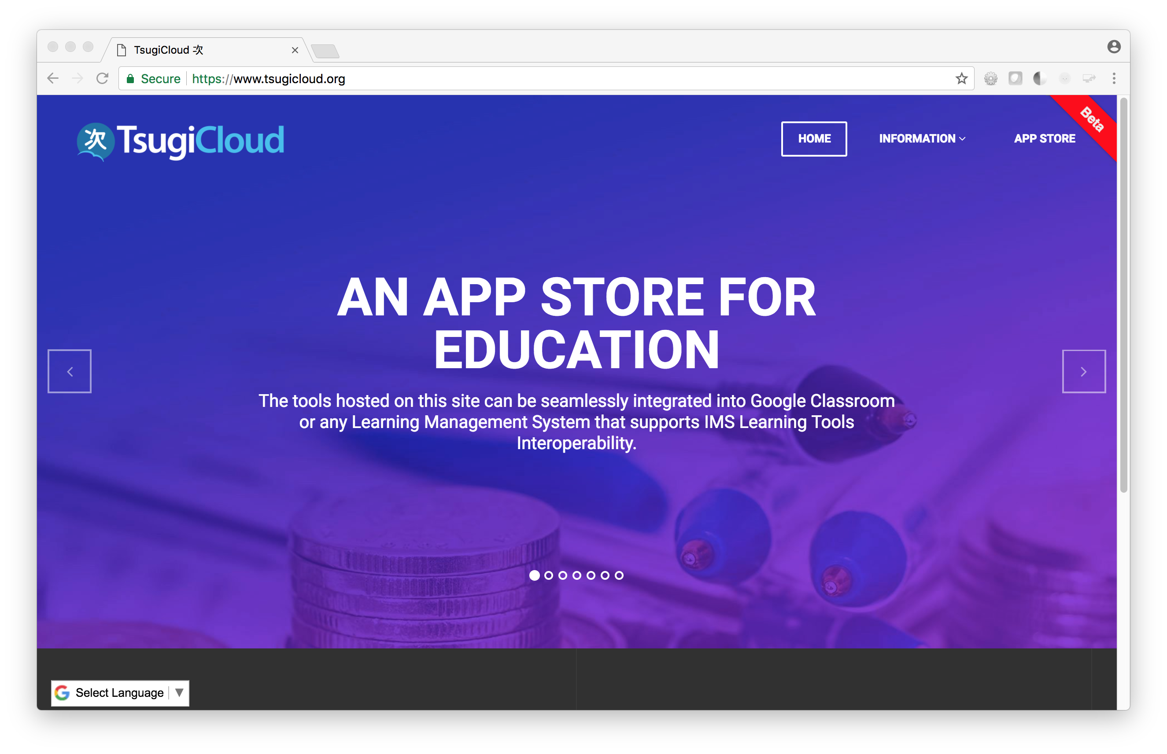
Tsugi: Building Applications for Education
Charles Severance
Faculty
Developers
Can build sharable assessments to support a textbook
Can build auto-graders for on-campus classes and reuse them in MOOCs
Can build *whatever* tool you can imagine
Write a Learning Tool once and use it in your on campus courses and in your MOOCs…
Write once integrate everywhere
Standards compliance made easy
Common UI / UX Patterns
Share / sell your tools in App Stores like TsugiCloud
Simple development environment
IMS LTI® IMS Deep Linking® IMS Common Cartridge®
Instructional Designers
Campus IT
Quickly design and create unique tools based on real faculty needs
Extend functionality for any LMS
Project Checklist
Weekly Reflection
YouTube Viewer with Analytics
Locally host learning applications
Support both on campus and MOOC usage
Consistent development approach for learning applications
Free online training for new campus developers
Photo Credit: https://pixabay.com/en/users/Free-Photos-242387/

